Slide 1
Part 9 MySQL Select

Slide 2
PHP MySQL Select
The SELECT statement is used to select data from a database.
Select Data From a Database Table
Syntax
SELECT column_name(s) FROM table_name
To get PHP to execute the statement above we must use the mysqli_query() function. This function is used to send a query or command to a MySQL connection.

Slide 3
Select_example
select * from students;
Select stno,stname from students;
Select stname from students;
Stno | stname
10 | Sami
11 | Rami
12 | Ali
13 | fahad

Slide 4
The WHERE clause
The WHERE clause is used to extract only those records that fulfill a specified criterion.
Syntax
SELECT column_name(s) FROM table_name WHERE column_name operator value
Example
Select stname from students where stno=10

Slide 5
The ORDER BY Keyword
The ORDER BY keyword is used to sort the data in a record set.
The ORDER BY keyword sort the records in ascending order by default.
If you want to sort the records in a descending order, you can use the DESC keyword.
Syntax
SELECT column_name(s) FROM table_name ORDER BY column_name(s) ASC | DESC

Slide 6
The ORDER BY Keyword Examples
Select stno,stname From students Order by stno;
Select stno,stname From students Order by stname desc;
Order by Two Columns
It is also possible to order by more than one column. When ordering by more than one column, the second column is only used if the values in the first column are equal:
SELECT column_name(s) FROM table_name ORDER BY column1, column2

Slide 7
Select in php
connect to MySQL and database
// Connects to your Database
include “conn.php”;
we will retrieve the information from the database table we created called “students"
// Collects data from "friends" table
$sql= "SELECT * FROM friends";
And we will then temporally put this information into an array to use:
$data =mysql_query($sql);
// puts the "friends" info into the $info array
$info = mysql_fetch_array( $data );

Slide 8
Cont..
Now let's print out the data to see if it worked:
// Print out the contents of the entry
Echo "<b>Name:</b> ".$info[‘stno'] . " ";
Echo "<b>Pet:</b> ".$info[‘stname'] . " <br>";
However this will only give us the first entry in our database. In order to retrieve all the information, we need to make this a loop. Here is an example:
while($info = mysql_fetch_array( $data ))
{
Echo "<b>Name:</b> ".$info[‘stno'] . " ";
Echo "<b>Pet:</b> ".$info[‘stname'] . " <br>";
}

Slide 9
Cont..
you can use index of col
while($info = mysql_fetch_array( $data ))
{
Echo "<b>Name:</b> ".$info[0] . " ";
Echo "<b>Pet:</b> ".$info[1] . " <br>";
}

Slide 10
Full_example
<?php
include "conn.php";
echo "<br>";
echo “stno stname”; echo "<br>";
echo “----- ---------”;
$sql="SELECT * FROM students";
$res=mysql_query($sql);
while($a=mysql_fetch_array($res))
{
echo $a[0]." ".$a[1]."<br>";
}
?>

Slide 11
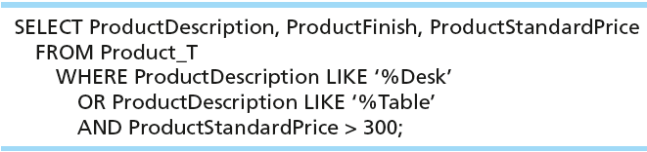
SELECT Example–Boolean Operators
AND, OR, and NOT Operators for customizing conditions in WHERE clause
Note: the LIKE operator allows you to compare strings using wildcards. For example, the % wildcard in ‘%Desk’ indicates that all strings that have any number of characters preceding the word “Desk” will be allowed

Slide 12
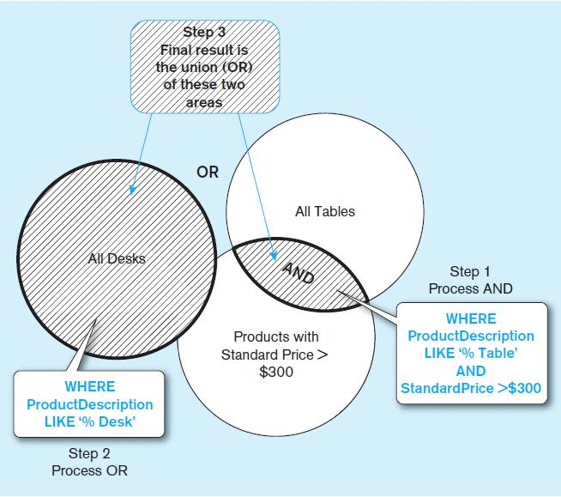
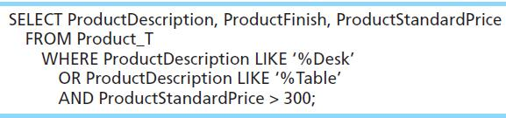
Boolean query A without use of parentheses
By default, processing order of Boolean operators is NOT, then AND, then OR

Slide 13
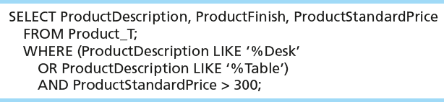
SELECT Example–Boolean Operators
With parentheses…these override the normal precedence of Boolean operators
With parentheses, you can override normal precedence rules. In this case parentheses make the OR take place before the AND.

Slide 14
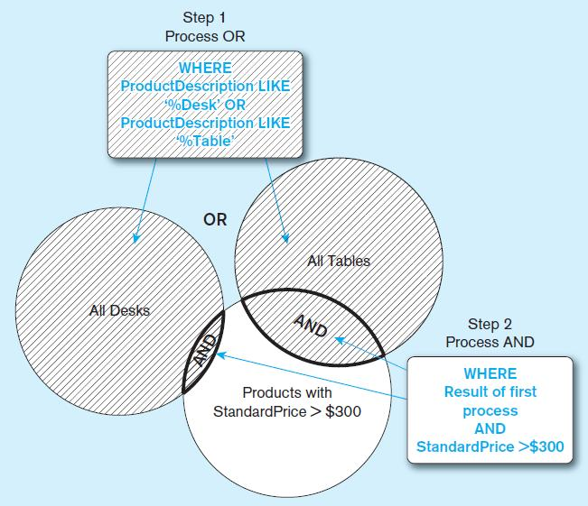
Boolean query with use of parentheses

Slide 15
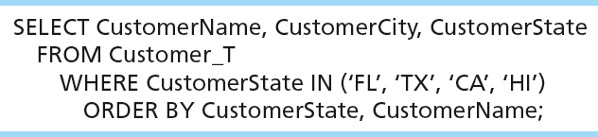
Sorting Results with ORDER BY Clause
Sort the results first by STATE, and within a state by the CUSTOMER NAME
Note: the IN operator in this example allows you to include rows whose CustomerState value is either FL, TX, CA, or HI. It is more efficient than separate OR conditions.

Slide 16
Using and Defining Views
Views provide users controlled access to tables
Base Table–table containing the raw data
Virtual Table–constructed automatically as needed; not maintained as real data
Dynamic View
A “virtual table” created dynamically upon request by a user
No data actually stored; instead data from base table made available to user
Based on SQL SELECT statement on base tables or other views
Contents materialized as a result of a query

Slide 17
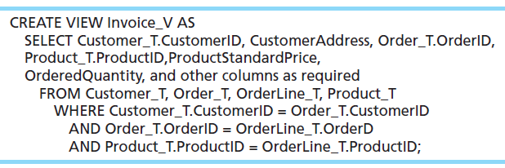
Sample CREATE VIEW
Query: What are the data elements necessary to create an invoice for a customer?
Save this query as a view named Invoice_V.

Slide 18
Advantages of Views
Simplify query commands
Assist with data security (but don't rely on views for security, there are more important security measures)
Enhance programming productivity
Contain most current base table data
Use little storage space
Provide customized view for user
Establish physical data independence

Slide 19
End of Presentation

